Slide 1
Academic Performance Analysis

Slide 2
Abstract:
In this, we mainly focus on the analysis of the students’ performance in academics not only external exams, but also the overall academic performance of each and every student. We segregate and calculate the performance of students using data. We then predict the performance of the students who are going to pass and fail based on previous result and also the predicted marks of a student using algorithm namely Linear Regression and SVM algorithm. In this project, we mainly focus on the analysis of the students’ performance and then predict the results through them using training data and then test data of academics not only external exams, but also the overall academic performance of each and every student.

Slide 3
Existing System:
In this paper, a dashboard is created for University Examination Result Analysis System. It determines the post and pre requirements as well as the processes of the University examination system. Depending on the result generated by the university a dashboard is created. In this paper analyzed the B.Sc. Data to create dashboard for decision-making. This study will help the universities and colleges to focus on critical subject, students’ performance on course wise, and subject wise. Subject and cumulative subject marks of course are considered for analysis.it has very low level of granularity having Theory, IA and Practical marks separately.
Disadvantages:
It only analyses the results of University exams only and not considers about the internal exams held in the institutions.
It does not contain any security mechanisms.

Slide 4
Proposed System:
We are creating a distributed application in which both internal and external academic performance of a student is considered for analyzing the performance of student. We collect, segregate and perform analysis on the acquired data using data mining techniques. Here we provide access to students to view their results of assignment, internal and external examinations. And the Administrator is given the access to update, delete and add user data and add, update and delete the users and generate report which can be viewed by users and professors. In order to predict the performance we use classification techniques.
Advantages:
We can access it from different computers.
No need of manually calculating and producing the result analysis.

Slide 5
Requirements:
SOFTWARE REQUIREMENTS:
• Operating System : Windows XP/Windows 7/8/10
• Scripting languages : Python
• Python Packages : Numpy, Pandas, Matplotlib
• Tools : Visual studio code, Xampp 4.3
HARDWARE REQUIREMENTS:
• Processor : Intel Pentium Inside
• RAM : minimum 1 GB
• Secondary Storage : minimum 160 GB
• Key Board : Standard Windows Keyboard
• Mouse : Two or Three Button Mouse

Slide 6
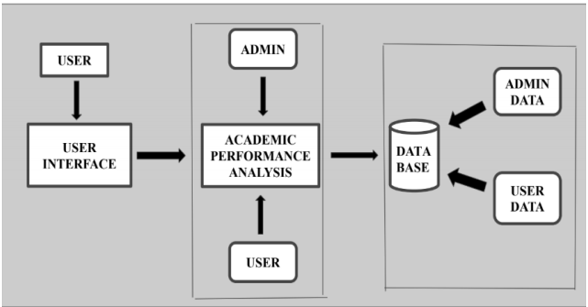
System Architecture:

Slide 7
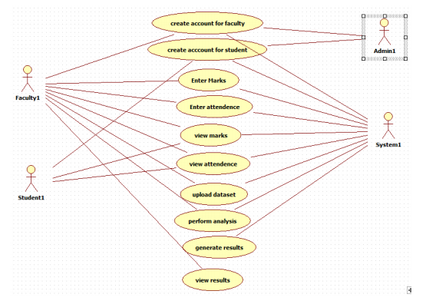
Use case Diagram:

